Slide 1
THE INDUCTIVE (EVIDENTIAL) VERSION OF THE ARGUMENT FROM EVIL
WILLIAM ROWE

Slide 2
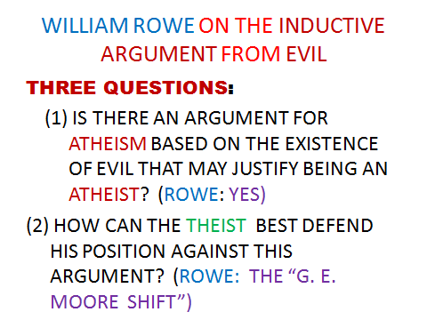

Slide 3
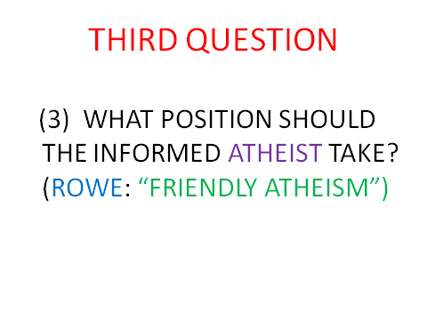

Slide 4
SOME DISTINCTIONS: TWO KINDS OF THEISM
NARROW THEISM: “THERE IS AN OMNIPOTENT, OMINISCIENT, ETERNAL, SUPREMELY GOOD BEING WHO CREATED THE UNIVERSE.”
BROAD THEISM: “THERE IS SOME SORT OF DIVINE BEING OR DIVINE REALITY”

Slide 5
TWO KINDS OF GOOD (BAD) [NOT MENTIONED BY ROWE]
INTRINSIC GOODNESS: A situation is intrinsically good if, considered all by itself, it would be a good thing.
CONSEQUENTIAL GOODNESS: A situation is consequentially good if it leads to good results.

Slide 6
SUFFERING & JOY
INTRINSICALLY BAD: UNWANTED, INTENSE, AND
PROLONGED PAIN.
INTRINSICALLY GOOD: INTENSE,
PROLONGED
JOY.

Slide 7
ROWE’S STATEMENT OF THE (INDUCTIVE) ARGUMENT FROM EVIL
There exist instances of intense suffering which an omnipotent, omniscient being could have prevented without thereby losing some greater good or permitting some evil equally bad or worse.
(2) An omniscient, wholly good being would prevent the occurrence of any intense suffering it could , unless it could not do so without thereby losing some greater good or permitting some evil equally bad or worse.

Slide 8
CONCLUSION
There does not exist an omnipotent, omniscient, wholly good being.
THIS IS ONLY PART OF THE ARGUMENT STRUCTURE. IS THIS PART DEDUCTIVELY VALID?

Slide 9
ROWE’S EVALUATION OF THE ARGUMENT (QUESTION 1: “YES”)
THE ARGUMENT IS DEDUCTIVELY VALID AND THE SECOND PREMISE IS QUITE REASONABLE. (p. 110)
THE FIRST PREMISE IS REASONABLE AS WELL (pp. 111-112)
There is an inductively strong argument from evidence that we have that the first premise is true.

Slide 10
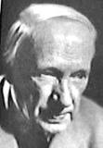
QUESTION 2: “THE G. E. MOORE SHIFT”

Slide 11
MOORE’S USE OF THE “G. E. MOORE SHIFT”: SKEPTICISM
I do know that this pencil exists.
If the skeptics principles are correct, I cannot know of the existence of this pencil.
Therefore:
(3) The skeptic’s principles (at least one) must be incorrect.

Slide 12
GENERAL STRATEGY OF THE SHIFT
I. P
Q
Therefore : R
Not-R
Q
Therefore: Not-P

Slide 13
LEIBNIZ VS. VOLTAIRE: THE SHIFT APPLIED TO A DEDUCTIVE VERSION OF THE ARGUMENT FROM EVIL
(1) God exists.
If God exists, He is omnipotent, omniscient, and all good.
An omniscient, omnipotent being, all-good being would create the best possible world.
Therefore:
(4) This is the best possible world.

Slide 14
VOLTAIRE’S SHIFT
If God exists, He is omnipotent, omniscient, and all good.
An omniscient, omnipotent being, all-good being would create the best possible world.
(4’) This is NOT the best possible world.
Therefore,
(1’) God does NOT exist.

Slide 15
THE THEIST’S APPLICATION OF THE SHIFT
(NOT-3) There DOES exist an omnipotent, omniscient, wholly good being.
(2) An omniscient, wholly good being would prevent the occurrence of any intense suffering it could , unless it could not do so without thereby losing some greater good or permitting some evil equally bad or worse.

